Slide 1
Predictive Maintenance Models in Nigerian Industrial Settings Using Machine Learning
AI SATURDAYS
1st November 2025

Slide 2
CONTENT
ABSTRACT
PROBLEM STATEMENT
AIM
PROJECT METHODOLOGY
DATA COLLECTION AND PREPARATION
DATA CLEANING AND FEATURE ENGINEERING
MODEL SELECTION AND TRAINING
MODEL EVALUATION
DEPLOYMENT AND MONITORING
CONCLUSION
RECOMMENDATION

Slide 3
ABSTRACT
This study applies machine learning to predict equipment failures using sensor, environmental, and maintenance data.
Through feature engineering, principal component analysis, and optimized classification models, predictive accuracy and reliability are improved.
The findings support proactive maintenance decisions, reducing equipment downtime and operational costs.

Slide 4
PROBLEM STATEMENT
Despite the availability of extensive sensor and operational data, many Nigerian industries still depend on reactive maintenance, leading to high costs and frequent downtimes.
AIM
This study aims to develop a predictive model using historical machine and sensor data to forecast equipment failures in advance and enable proactive, data-driven maintenance decisions
We were able to get access to a predictive maintenance dataset from Kaggle

Slide 5
Project Methodology
Data Collection and Preparation
1
1
Data Cleaning and Feature Engineering
2
2
Model Selection and Training
3
3
Model Evaluation
4
4
Deployment and Monitoring
5
5

Slide 6
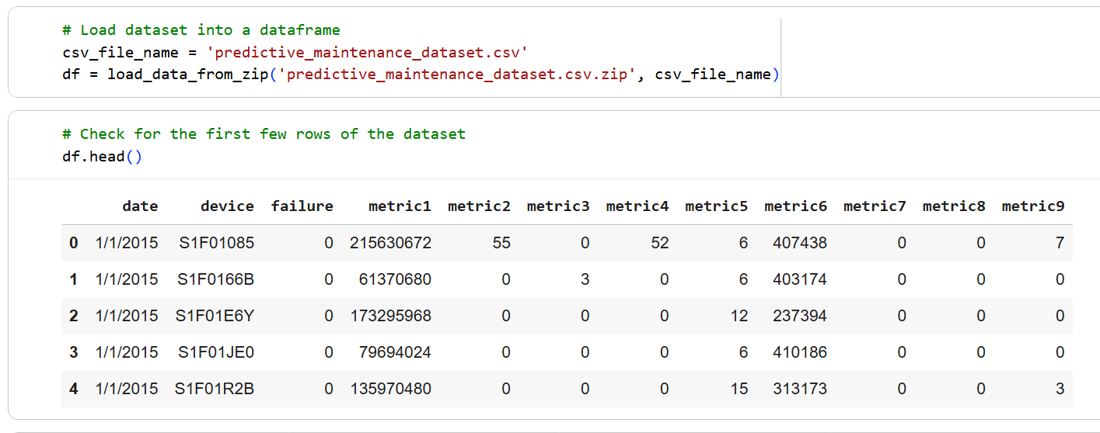
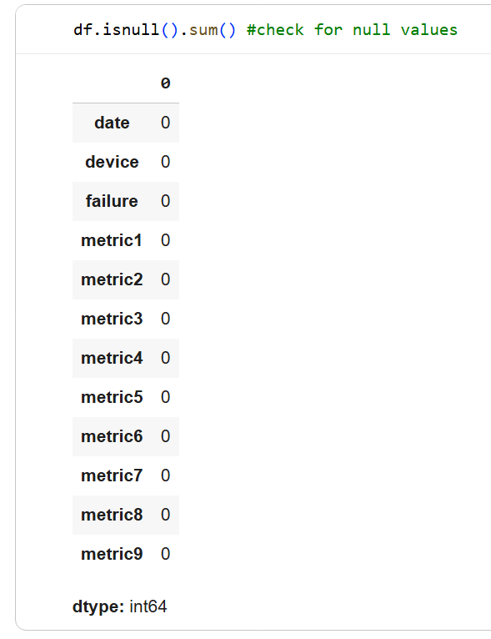
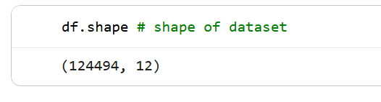
DATA COLLECTION AND PREPARATION

Slide 7
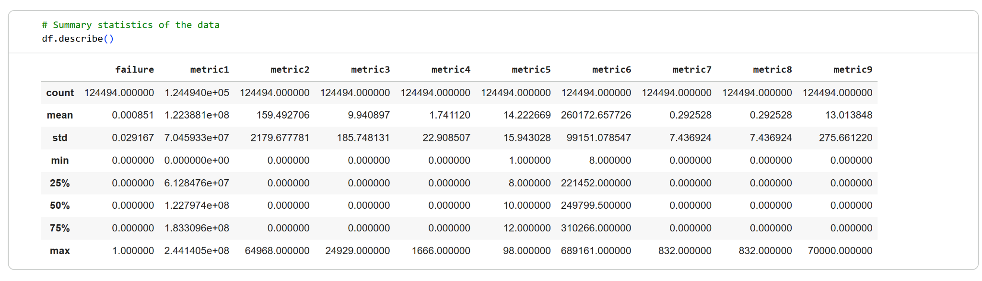
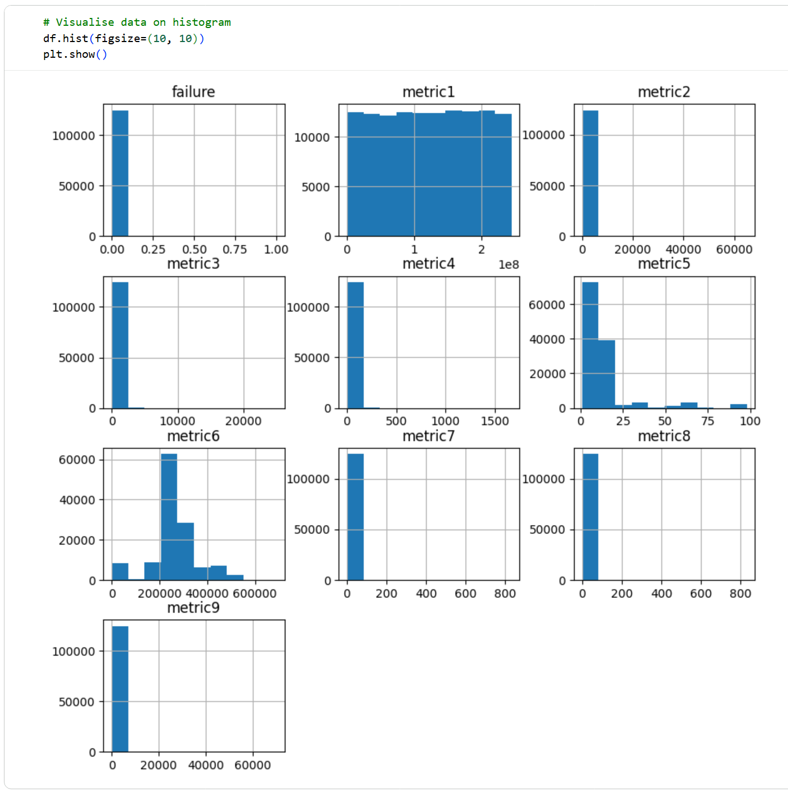
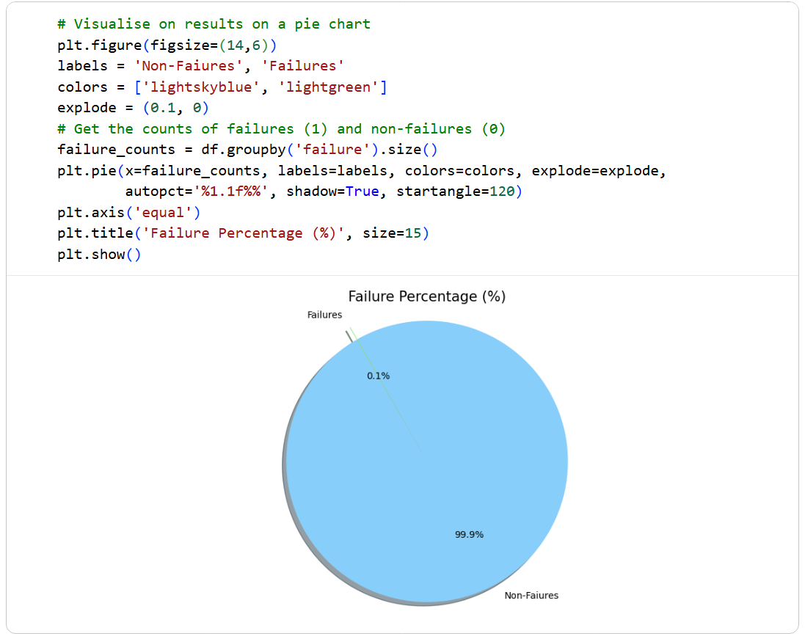
DATA COLLECTION AND PREPARATION CONT.

Slide 8
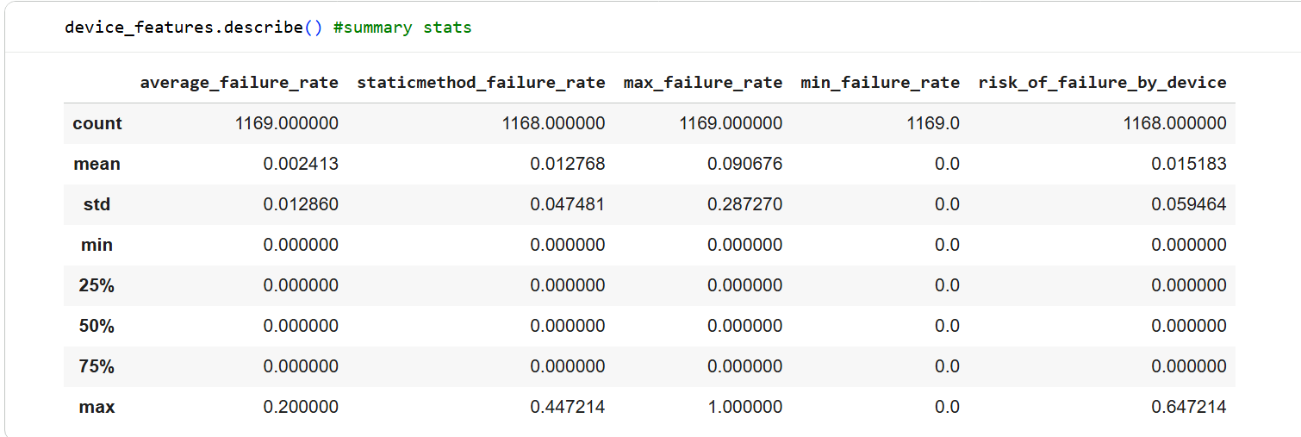
FEATURE ENGINEERING

Slide 9
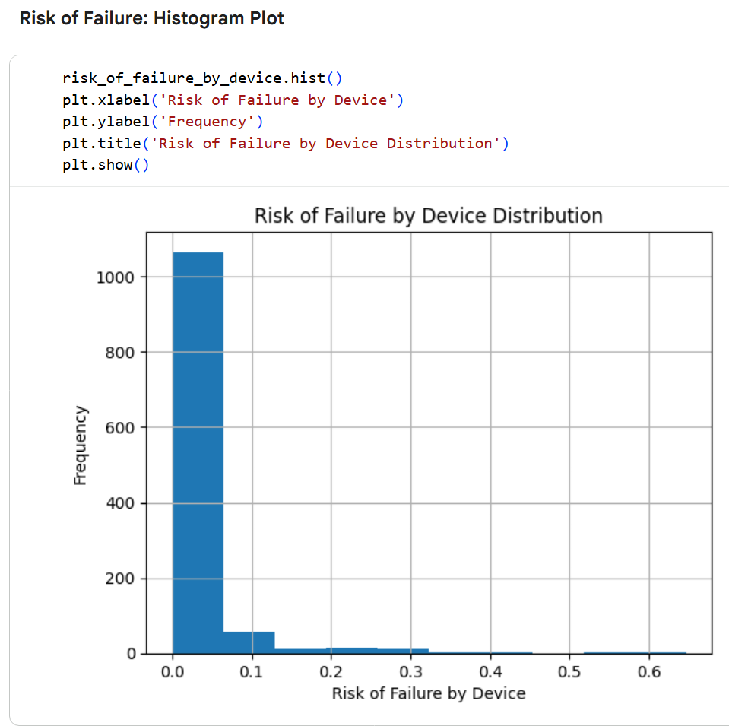
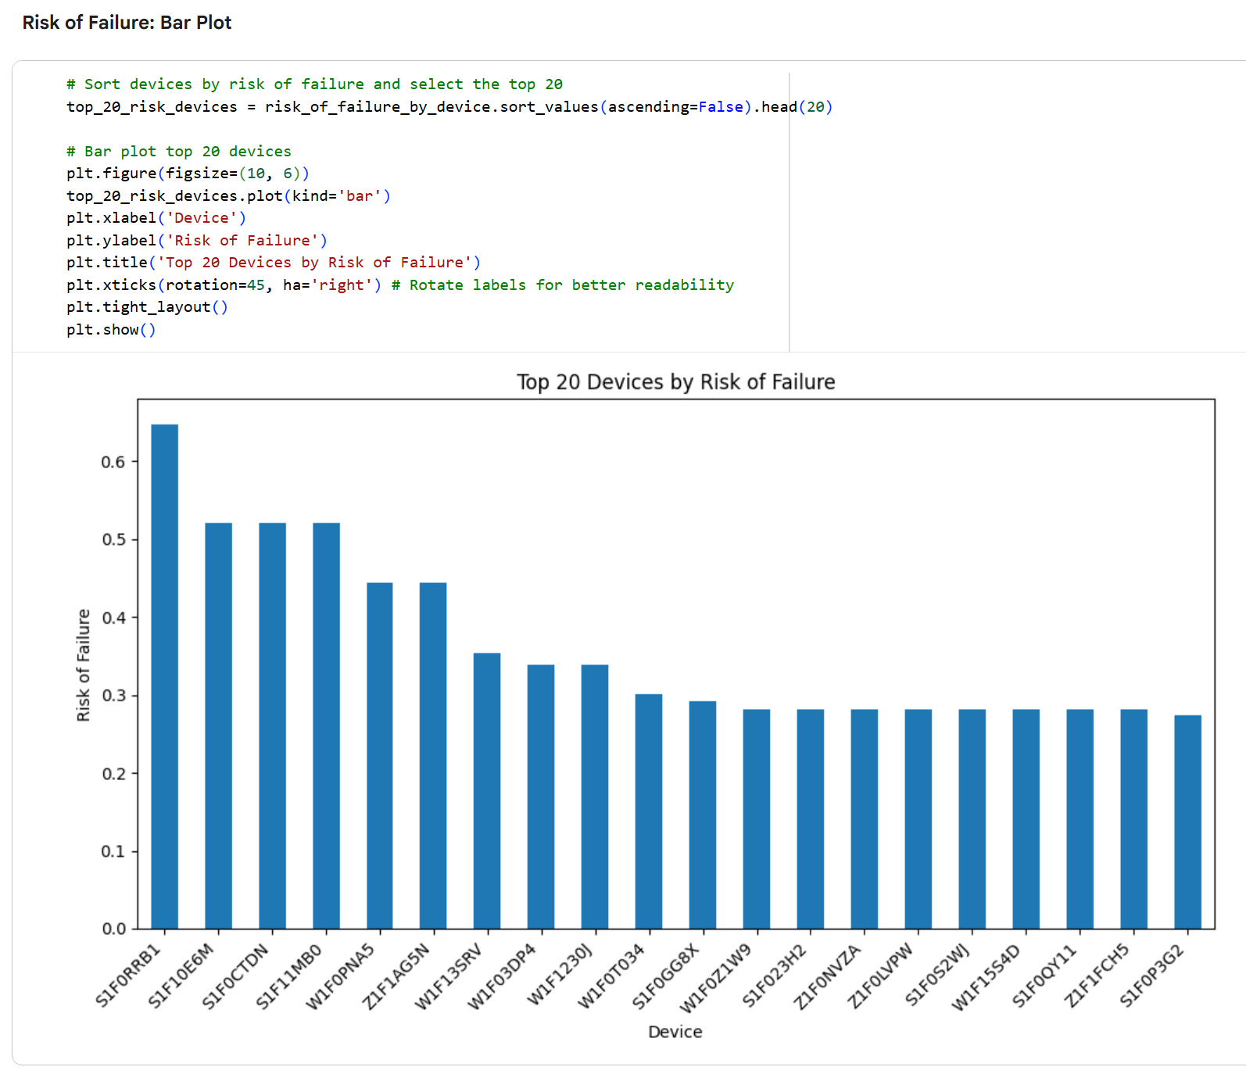
FEATURE ENGINEERING

Slide 10
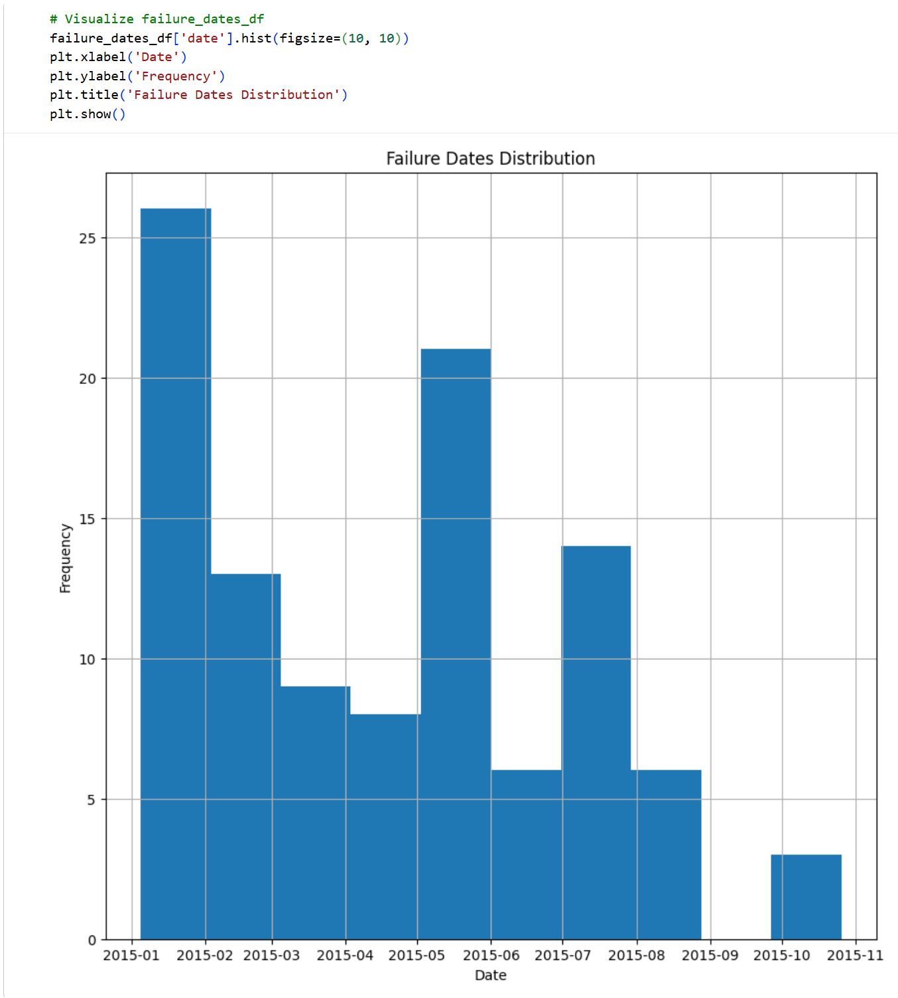
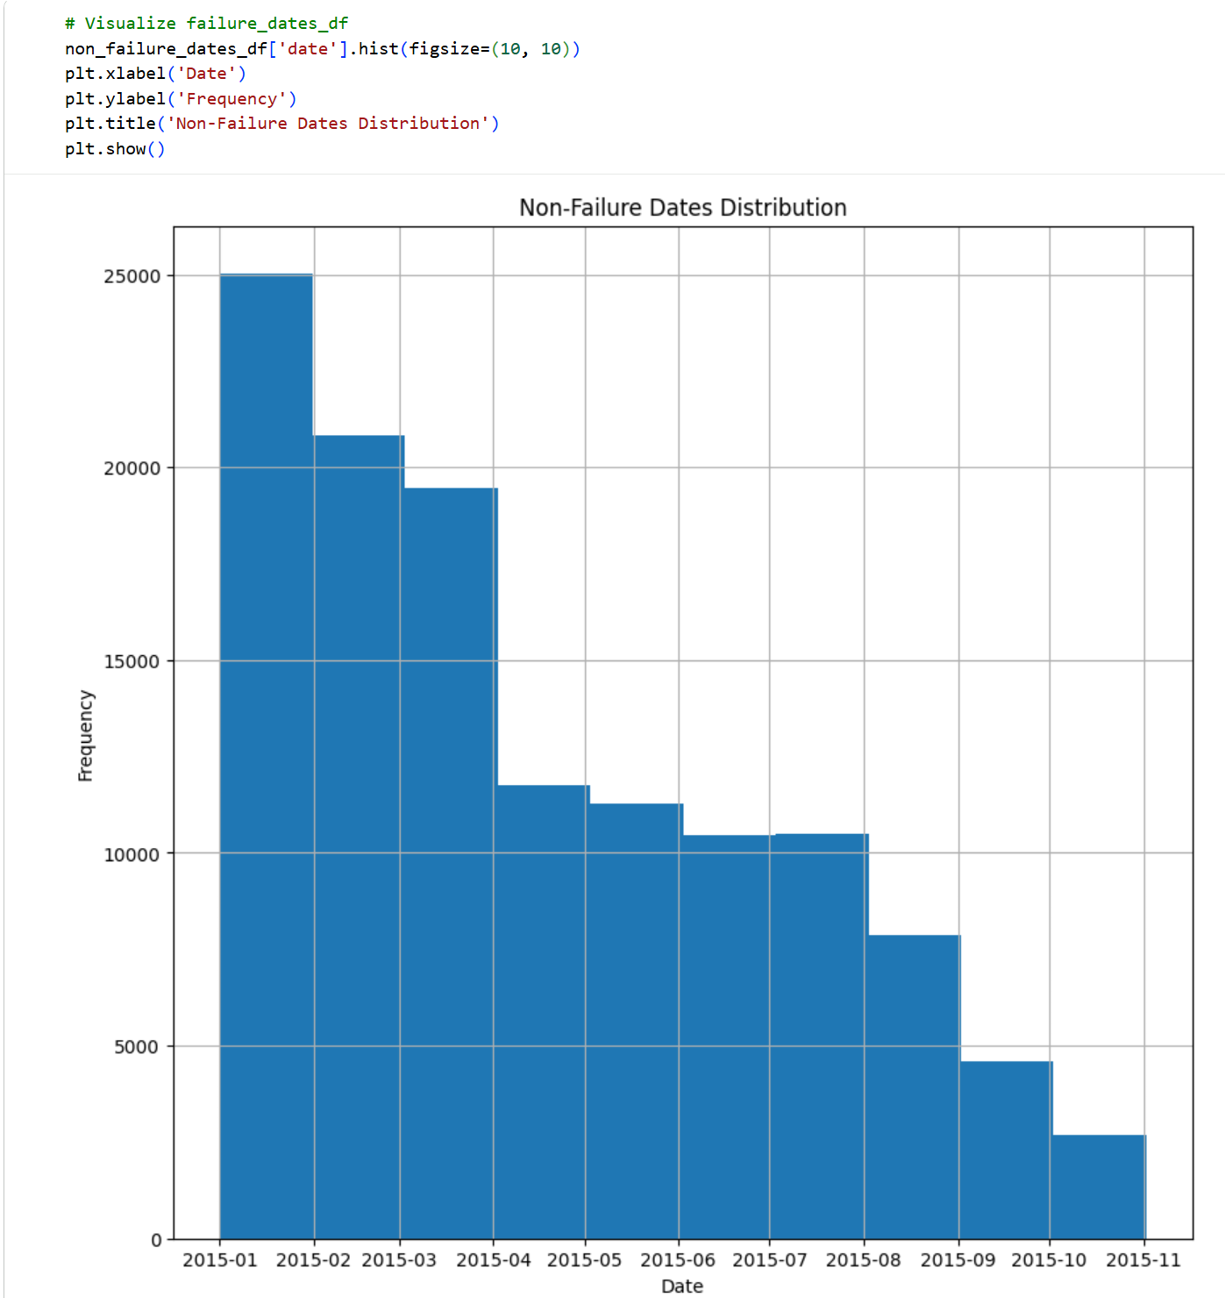
FEATURE ENGINEERING

Slide 11
FINDING AND DISCOVERIES
The results of our data exploration and visualization include the following:
No missing values were present in the dataset.
There were 124,493 unique rows after dropping duplicates.
The target variable (failure) is highly imbalanced, with only 106 instances of failure (0.1%) compared to 124,387 instances of non-failure (99.9%).
There are 1169 unique devices in the dataset.
Visualizations of device counts showed a skewed distribution, with some devices having significantly more data points than others.
Histograms of the metric features indicated varying scales, suggesting the need for feature scaling.
Failures are highly imbalanced and concentrated on specific dates, with January and May 2015 showing the highest frequency of failure events.
Over 1000 devices have a calculated failure risk close to zero, confirming that most devices are highly reliable with minimal failure history.
Device S1FORRB1 stands out as the most failure-prone, with the highest calculated risk of failure among all devices.

Slide 12
MODEL SELECTION AND TRAINING
Problem Type:
Since the target variable (y) has two classes: 0 for non-failure and 1 for failure. We can conclude that this is a classification problem.
Data Split:
Train Set: 70% | Test Set: 30%
Developed Machine Learning Models:
Linear Discriminant Analysis (LDA)
Logistic Regression
Random Forest
Support Vector Machine (SVM)
K-Nearest Neighbors (KNN)
Decision Tree
MLP Classifier
Naive Bayes
XGBoost
CatBoost

Slide 13
MODEL EVALUATION
Initial Evaluation (Train/Test Split):
After training each model, we evaluated them on both the training and test sets.
Metrics used:
Accuracy
Overfitting Check:
We compared model performance on training vs. test data.
Some models (e.g., Decision Tree, XGBoost, CatBoost) overfit : high train accuracy but lower test accuracy.
Hyperparameter Tuning:
We Used RandomizedSearchCV for:
K-Nearest Neighbors
Logistic Regression
MLP Classifier
Also used RidgeClassifierCV for regularization.
Evaluated tuned models again using accuracy.
Dimensionality Reduction with PCA:
Reduced features to 11 principal components.
Re-ran model training and evaluation on PCA-transformed data.
Compared performance again using accuracy and F1 score.

Slide 14
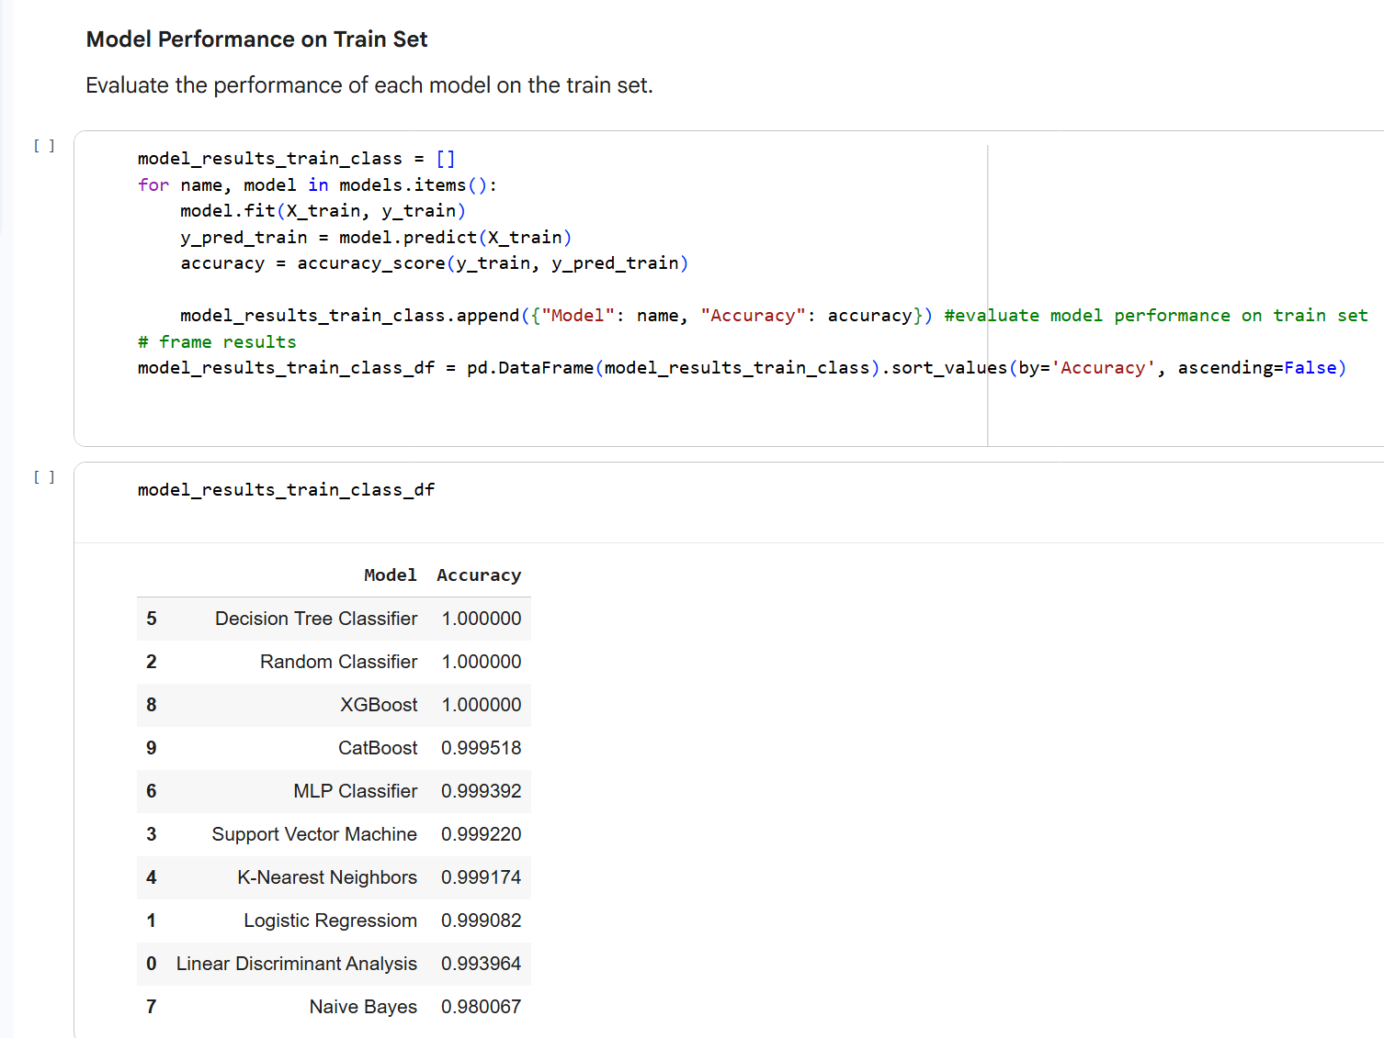
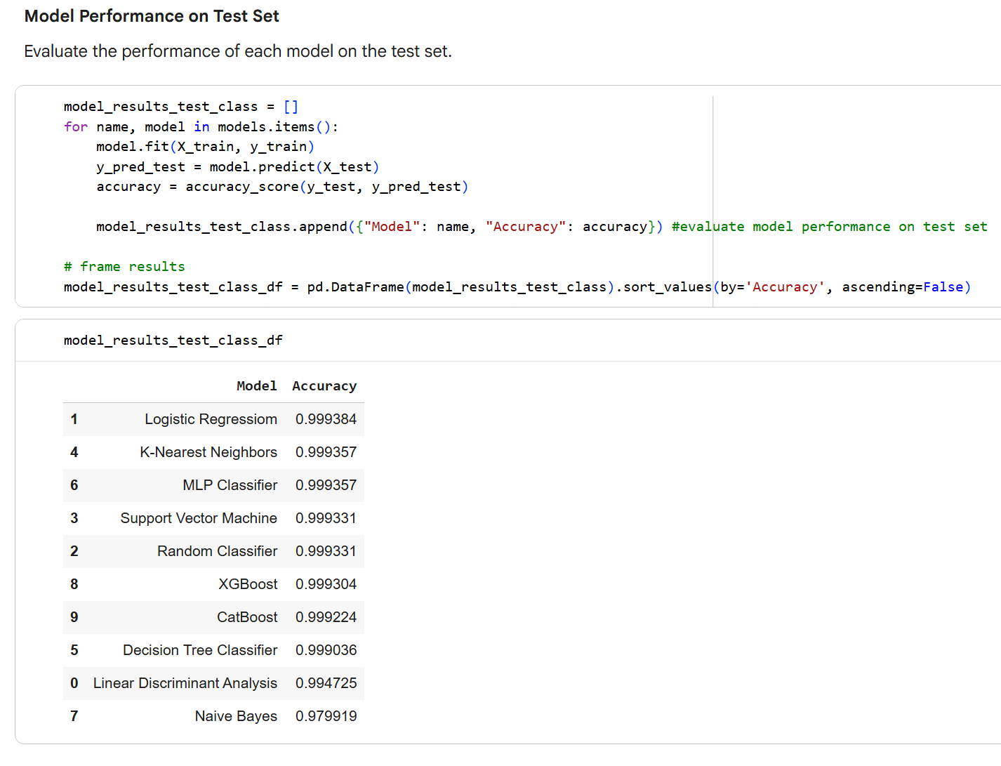
MODEL EVALUATION

Slide 15
CONCLUSION
IMPROVING OUR MODELS
After Applying PCA
Based on model deployment and analysis of the test data after applying PCA here are the key findings:
The MLP Classifier achieved the highest accuracy on the test data at 99.941%.
The K-Nearest Neighbors model had an accuracy of 99.933%
The Logistic Regression model had an accuracy of 99.927%
These results indicate that all three models performed very well on the test data, with the MLP Classifier showing a slight edge in accuracy. The application of PCA seems to have helped in achieving high accuracy on the unseen test data with a reduced number of features.

Slide 16
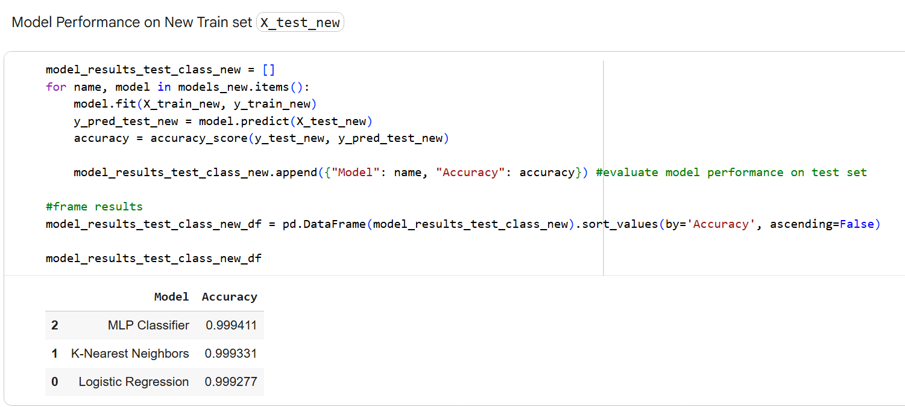
Machine Learning

Slide 17
RECOMMENDATION
We would recommend the Nigerian Industries to use:
Modern machine learning models such as XGBoost, LightGBM, and anomaly detection tools to better predict failures.
We would also advise them to:
Collect a larger, more diverse dataset across multiple factories to improve model generalization and reliability.
Continuously update and retrain the model with new sensor data to adapt to changing equipment conditions and usage patterns.
Implement the model within a real-time monitoring system to alert engineers of potential failures before they occur.

